Slide 1
Addressing Housing Insecurity
Facilitated in partnership with Michigan State Housing Development Authority
Zoom
January 18, 2022

Slide 2
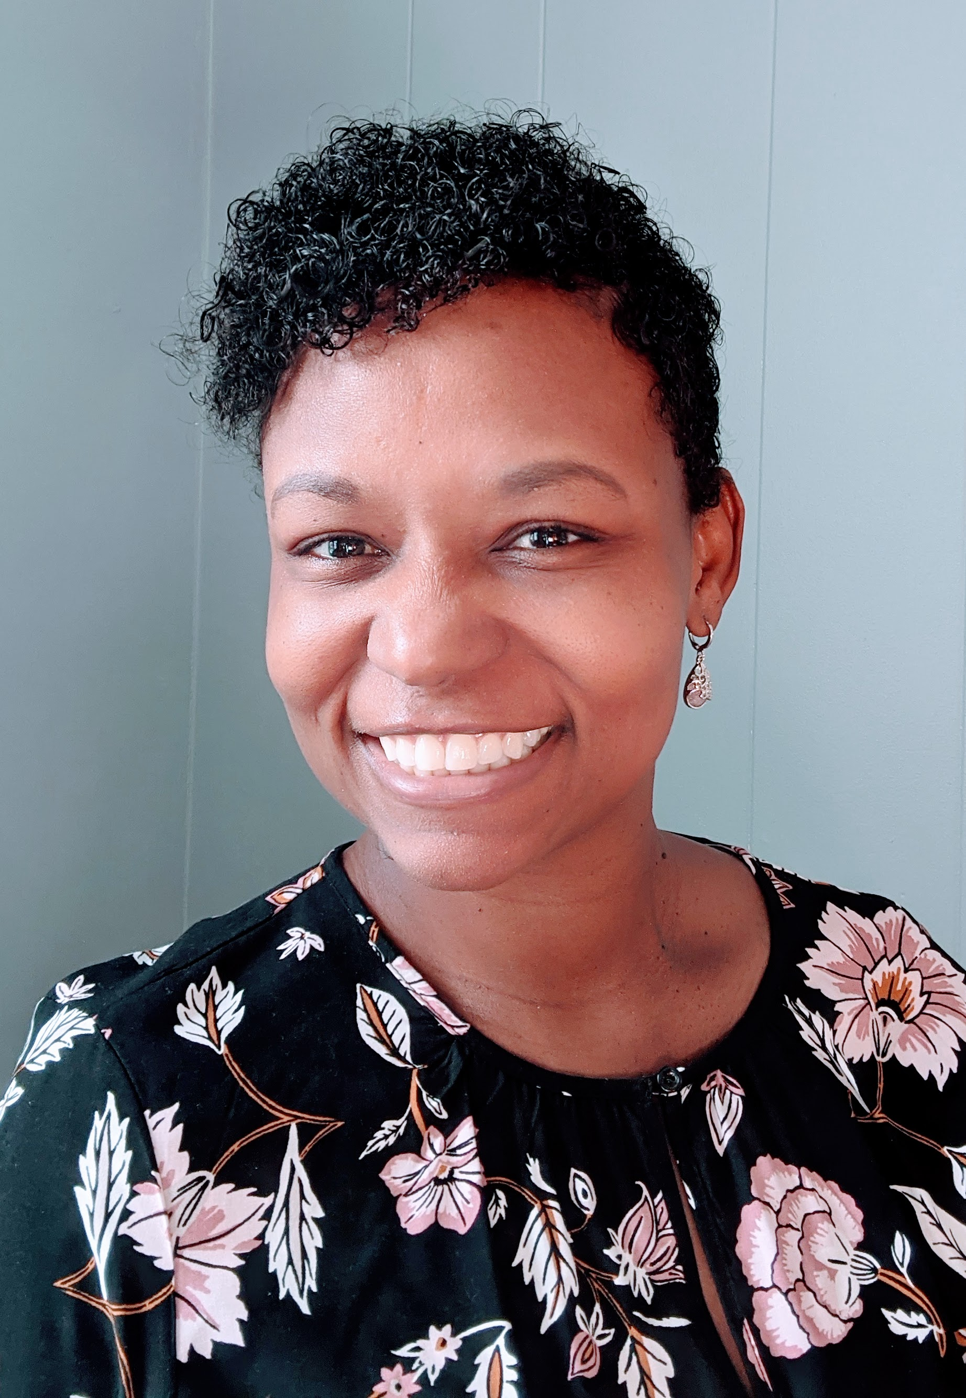
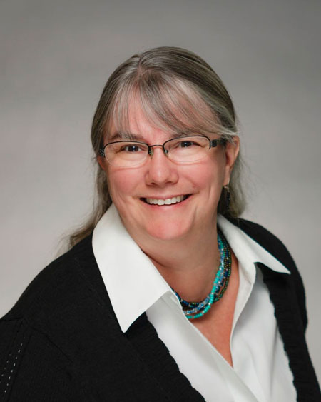
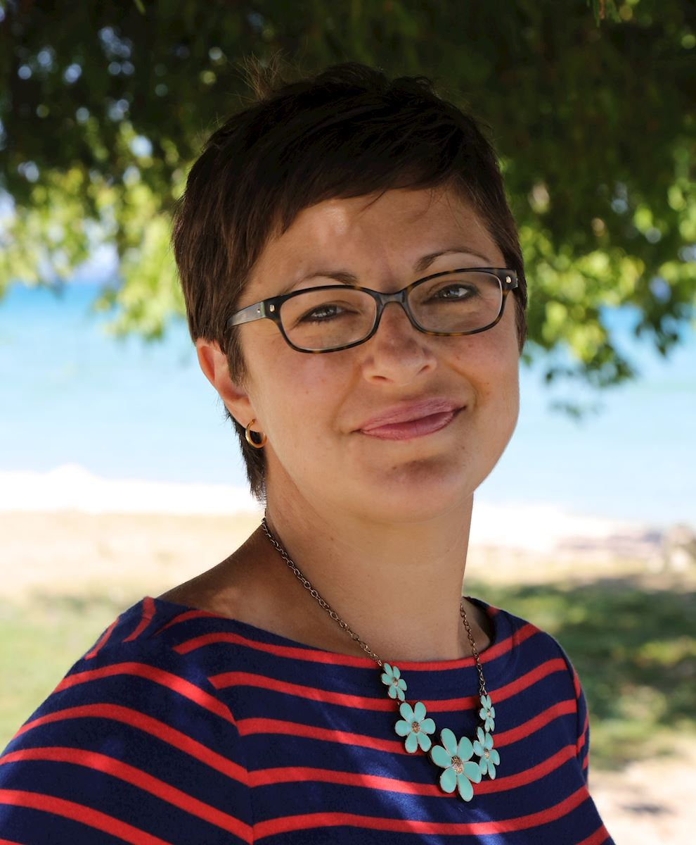
MCSS Staff
Precious Miller
Jenny Schanker
Erica Orians
Katie Giardello

Slide 3
Welcome!
Sue Ortiz
Chief Program Officer
Habitat for Humanity Michigan
Diana Hanna
Housing and Family Services Director
True North Community Services

Slide 4
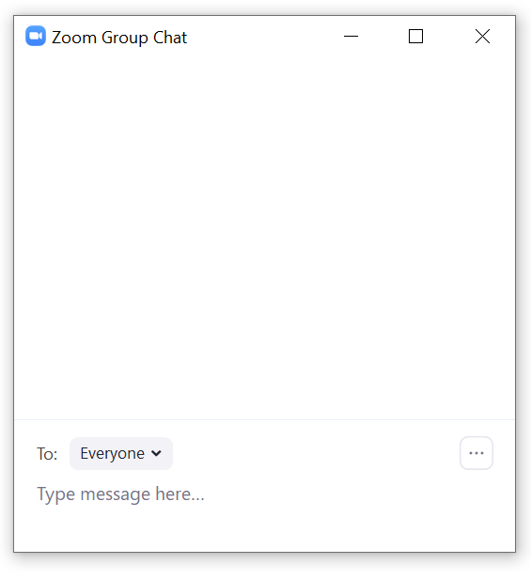
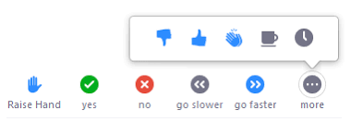
Engagement
Rename yourself to include your college
Use Chat to ask questions
and share resources (and links)
Raise hand to speak

Slide 5
Agenda
9am Welcome, Introductions, Data Review
9:05am Housing Counseling Services
9:30am Homeless Services
9:55am Conclusion

Slide 6
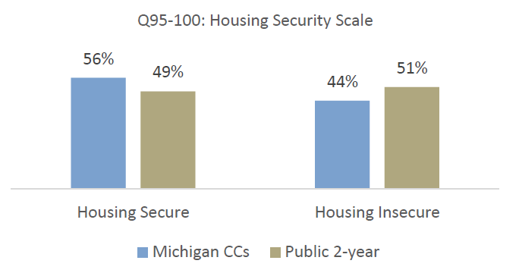
Michigan Students & Housing Insecurity
Almost half of respondents showed signs of being housing insecure within the 12 months prior to the Fall 2020 Survey.
15% of respondents indicated being homeless since starting college or within the 12 months prior to the survey.
Respondents with housing insecurity also responded at higher rates that they worry about having enough money to pay for school.
Notes:
define a homeless person as “a person without a place to live, often residing in a shelter, an automobile, an abandoned building or outside,” and housing insecurity as, “broader set[s] of challenges such as the inability to pay rent or utilities or the need to move frequently.
Students who struggle to meet basic needs like food, housing, and utilities are vulnerable to enrollment disruptions regardless of their academic ability or potential.

Slide 7
Welcome
Sue Ortiz
Chief Program Officer
Habitat for Humanity Michigan
Diana Hanna
Housing and Family Services Director
True North Community Services

Slide 8
Conclusion
Share this information with your circle
Create communication strategy to share w/ students
Connect with your local resource agency

Slide 9
Follow us on Social Media

Slide 10
Contact Us
Precious Miller, Coordinator of MI-BEST
pmiller@mcca.org
Erica Orians, Executive Director
eorians@mcca.org
Jenny Schanker, Director of Research and Institutional Practice
jschanker@mcca.org
Katie Giardello, Manager of Network Engagement
kgiardello@mcca.org

Slide 11
References
MCCA Events
Trellis Research
MSHDA
MiBridges
Notes:
Add resources from colleges

